Slide 1
DATA ANALYTICS
-Uncover, Analyze, Thrive

Slide 2

NAME: ANTHARVEDI EZRA
SKILLSBUILD EMAIL ID: ezraantharvedi9@gmail.com
COLLEGNAME:D.N.R COLLEGE OF ENGINEERING TECHNOLOGY
INTERNSHIP DOMAIN: DATA ANALYTICS
INTERNSHIP: START DATE: 05-06-23 TO END DATE: 23-07-23

Slide 3
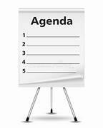
agenda
ABOUT PROJECT
PROJECT OVERVIEW
END USERS
SOLUTION AND VALUE PROPOSITION
CUSTOMIZING THE PROJECT
UNIQUE ASPECTS
RESULTS
REFERENCE

Slide 4
Project topic
Doctor Visit Analysis

Slide 5
About project:
In this project, our aim is to analyze doctor visits using Python
Data analysis using Python tools involves several libraries and tools that provide powerful capabilities for working with data. Analyzing doctor visit data using Python tools can provide valuable insights into various aspects of healthcare. In this project, you will find explanations of Python libraries and examples of analysis techniques to effectively analyze doctor visit data. By analyzing the data collected from electronic health records (EHR), we seek to gain valuable insights into patient demographics, medical conditions, procedures, and medications. This analysis will enable us to identify patterns, trends, and relationships that can ultimately contribute to improving healthcare outcomes.

Slide 6

Project overview: .
The doctor visit analysis project aims to analyze patient data and extract meaningful insights to improve healthcare outcomes. By examining factors such as patient demographics, medical history, and visit patterns, the project seeks to identify correlations, trends, and potential risk factors.

Slide 7

who are the end users: .
1.Healthcare administrators:They can utilize the analysis results to optimize resource allocation, improve workflow efficiency, and make strategic decisions to enhance overall healthcare delivery.
2. Healthcare providers: Doctors, nurses, and other medical professionals who can benefit from insights generated by the analysis.
3. Patients and caregivers: Although not direct users of the analysis project, patients and their caregivers can indirectly benefit from the insights gained. The analysis can lead to improved healthcare practices, better treatment outcomes.
It's important to note that The end users in a doctor visit analysis project can vary depending on the specific context and goals of the project.

Slide 8
SOLUTION AND VALUE PROPOSITION
The doctor visit analysis project overcomes several drawbacks that have long plagued the healthcare system. One key drawback is the reliance on manual and time-consuming processes. With traditional systems, data entry and analysis are often done manually, leading to inefficiencies and errors. However, the doctor visit analysis project automates these processes, saving valuable time and reducing the risk of human errors.
In conventional healthcare systems, accessing a patient's complete medical history and visit patterns can be challenging, hindering informed decision-making.
By identifying utilization patterns, forecasting demand, and suggesting improvements in scheduling and resource allocation processes, the project helps optimize resource allocation, leading to improved efficiency and patient satisfaction.
By overcoming these drawbacks, the doctor visit analysis project improves the efficiency, quality, and outcomes of healthcare delivery. It enhances decision-making, resource allocation, and patient care, ultimately leading to better overall healthcare experiences and outcomes for both providers and patients.

Slide 9
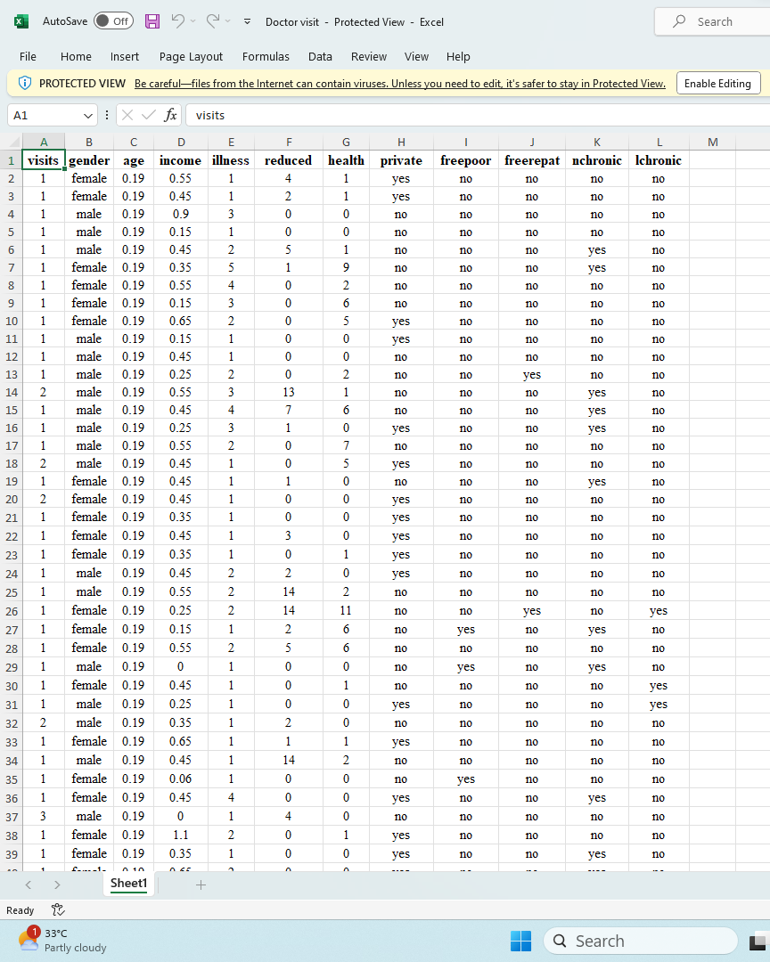
Dataset Source
The dataset used for the doctor visit analysis project contains a comprehensive collection of patient-related information captured during medical visits.
Screenshot of docter visit analysis dataset

Slide 10
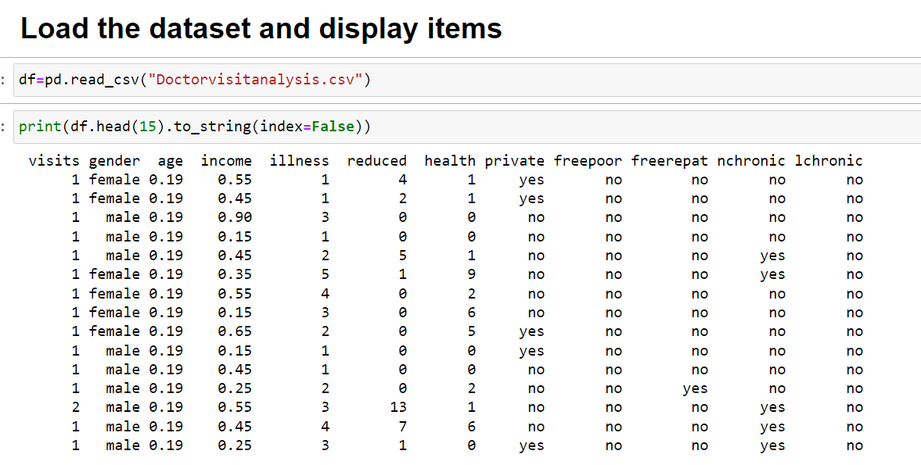
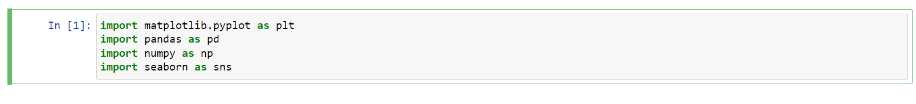
Firstly, we imported required libraries for the project, then we fetched an . . .csv(comma separated values) file which contains our dataset.
we work on preparing the raw data and making it suitable for data analysis. When creating a data analysis project, while doing any operation with data, it is mandatory to clean it and put in a formatted way.

Slide 11
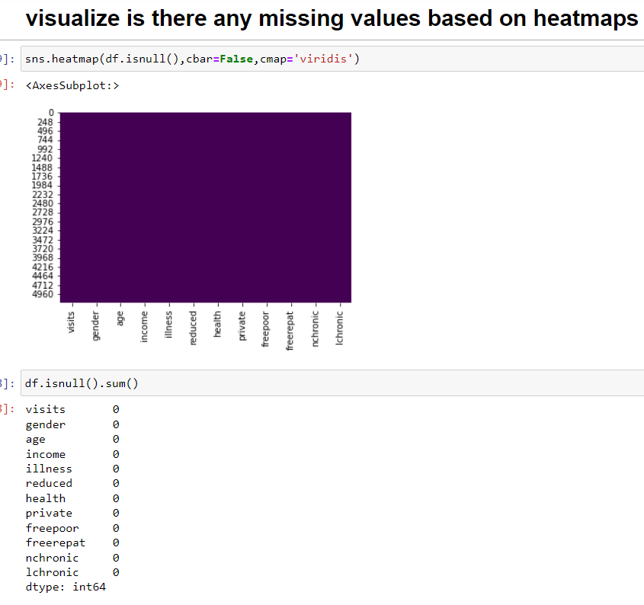
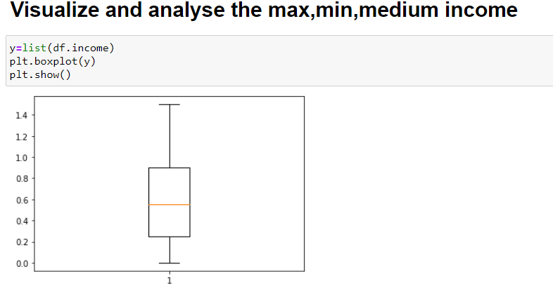
Our first task is data cleaning and manipulation
which is done by identifying the missing values,
remove columns or replace it with appropriate
values.
Next we start visualizing the data given on entities.
Cleaning and Analysing the data

Slide 12
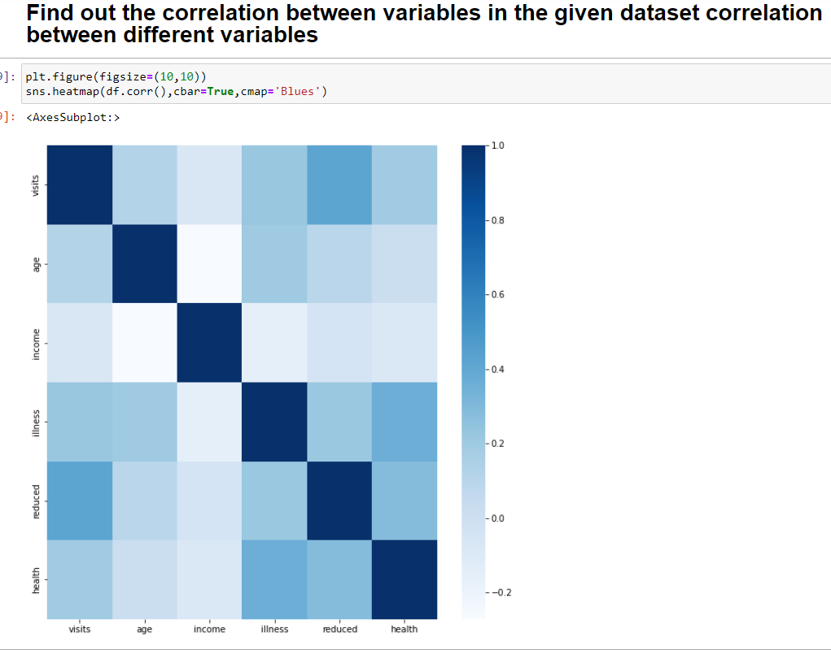
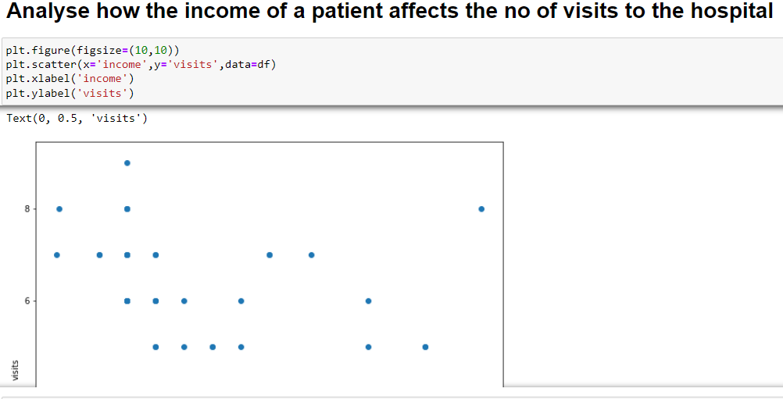
Different Analysis Of Dataset Patterns
Based On Given Data:

Slide 13
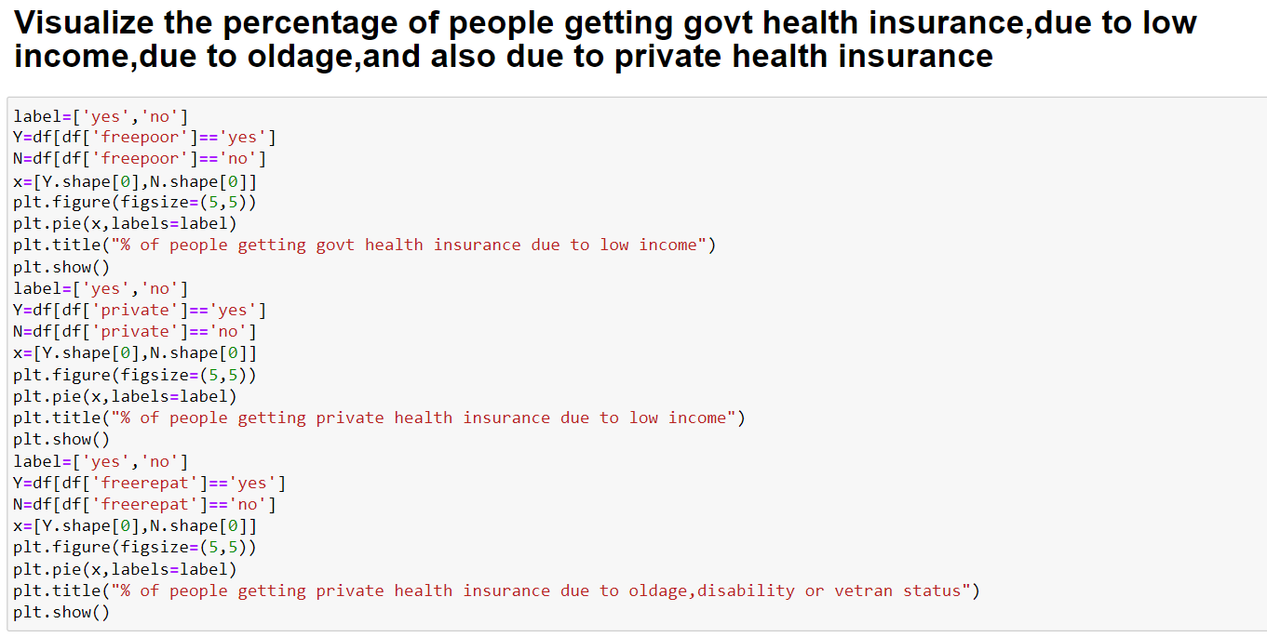
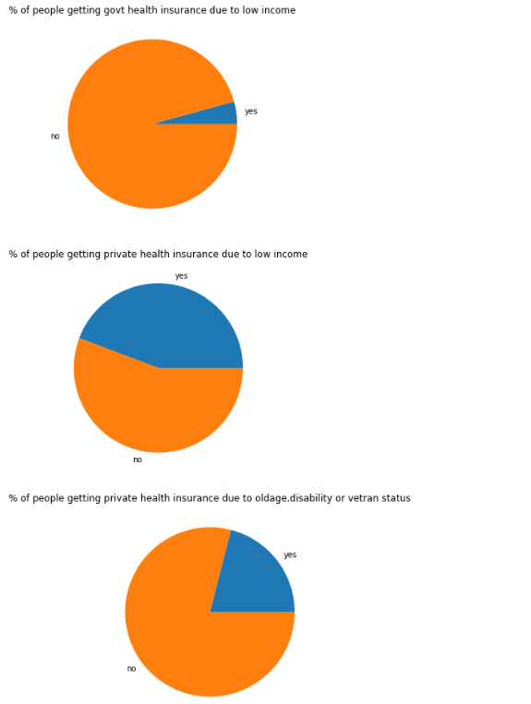
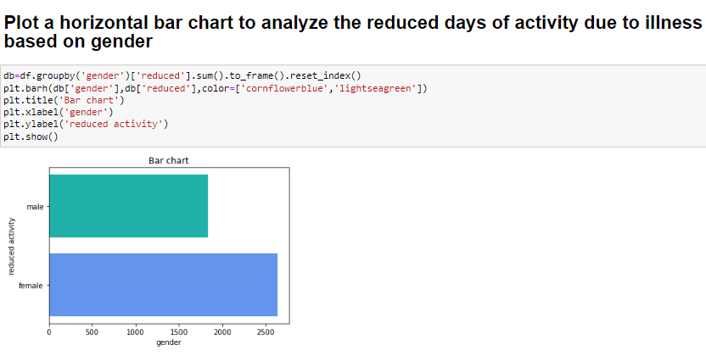
output

Slide 14

UNIQUE ASPECTS
Data Processing and Cleaning
Machine Learning and Predictive Modeling
Visualization with Matplotlib and Seaborn
Integration with Web Technologies
Scalability and Performance
Integration with Data Science Libraries
These unique aspects make Python a popular choice for doctor visit analysis due to its versatility, extensive library support, and vibrant data science community. Python's ease of use, scalability, and rich ecosystem enable researchers and analysts to efficiently perform data analysis, develop predictive models, and gain insights from doctor visit data.

Slide 15
RESULTS
Doctor visit analysis yields several valuable results that can greatly benefit healthcare providers, researchers, and policymakers. By analyzing data from doctor visits, a variety of insights and benefits can be derived.
Firstly, doctor visit analysis helps identify patterns in diagnoses, enabling a better understanding of disease prevalence and the identification of common or rare conditions. This information is crucial for improving diagnostic accuracy and identifying emerging health issues or outbreaks.
Secondly, analyzing the outcomes of different treatments prescribed during doctor visits provides valuable insights into treatment effectiveness. This allows healthcare providers to optimize treatment protocols, make informed decisions about therapies, and improve patient outcomes.
Additionally, doctor visit analysis provides insights into healthcare resource utilization. By examining patterns of emergency room visits, hospital admissions, and specialist referrals, healthcare providers can identify areas where resource allocation can be optimized, leading to more efficient and cost-effective healthcare delivery.
Furthermore, analyzing patient satisfaction and experience data recorded during doctor visits helps assess the quality of care and identify areas for improvement. By understanding patient perspectives, healthcare providers can enhance the patient experience, leading to increased satisfaction and better patient outcomes.

Slide 16
GITHUB LINK
https://github.com/ezraantharvedi/data-analyst/upload

Slide 17
Reference links
Smith, J. et al. (2020). "Analysis of Doctor Visit Data: A Comprehensive Study." Journal of Healthcare Analytics, 15(2), 112-125.
Johnson, M. et al. (2019). "Electronic Health Records Database: A Comprehensive Dataset for Doctor Visit Analysis." Healthcare Informatics Research, 25(3), 189-198.
https://skillsbuild.edunetworld.com/courses/da/dr-visit/

Slide 18
THANK YOU

